Slide 1
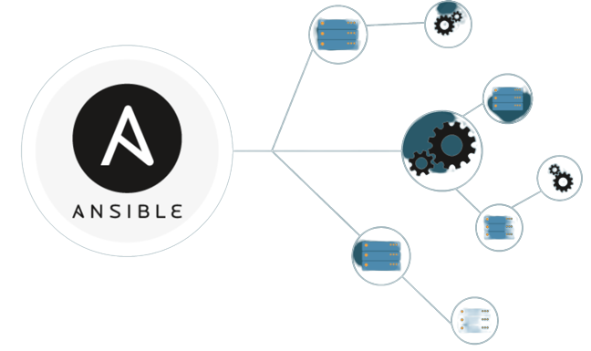
Ansible

Slide 2
Topics ?
Following are the topics covered in this Module :
Introduction to Ansible
Ansible Architecture
Setting up Ansible
Ad-hoc commands in Ansible
Ansible Playbook
Roles in Ansible

Slide 3

What is Ansible ?
Ansible is a deployment automation tool which traditionally uses push approach to archive its objectives, by managing all the servers through one single machine running the Ansible Configuration Management Tool.

Slide 4
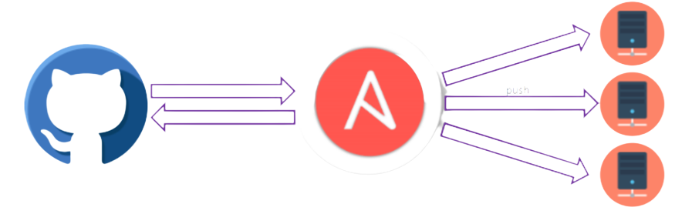
Ansible Push Approach
Ansible Clients do not have any agents installed on them, therefore there is no concept of polling with central server. Ansible uses the Push approach instead. Still, Ansible is Flexible enough to be let the user implement Pull architecture as well.

Slide 5
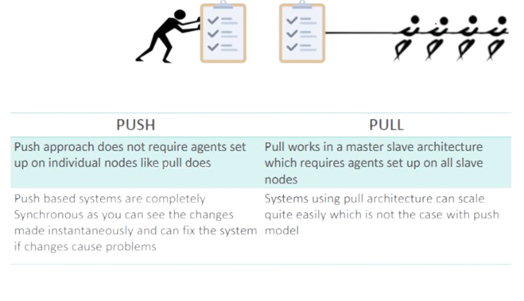
How is push different from Pull ?
.

Slide 6
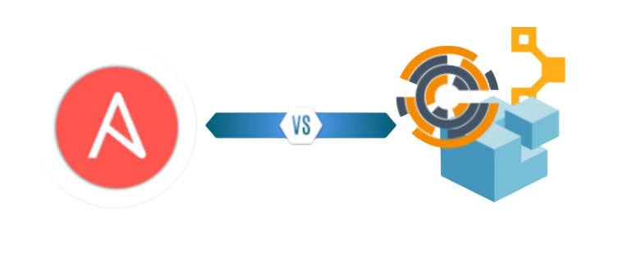
Ansible VS Others
Ansible is much easier to work with compared to the like of Puppet, Chef etc
Ansible does not require agents set up on individual nodes
Ansible also supports the pull architecture
It’s simple enough for new users and also works at high enough level to work with other tools as well

Slide 7
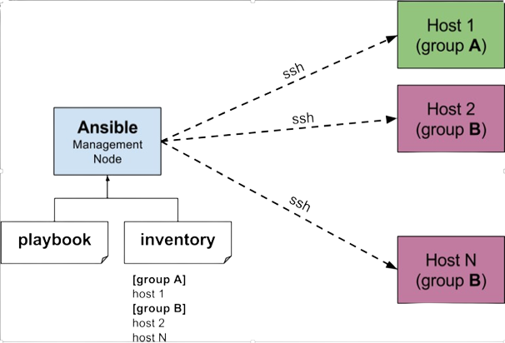
Ansible Architecture
.

Slide 8
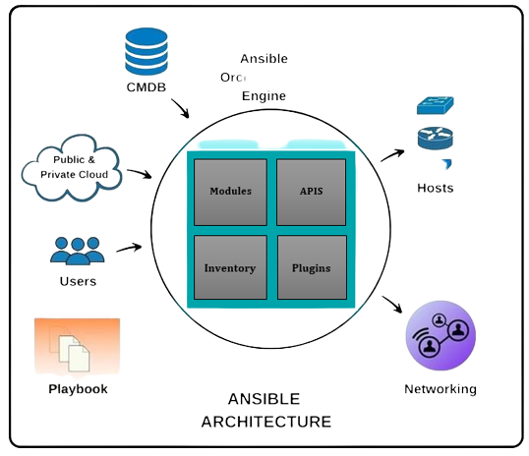
What is Selenium ?
.

Slide 9

What exactly is a playbook ?
Playbooks are the access point to Ansible provisioning.
It’s the Ansible’s way of deploying and configuring different remote servers and environments
It is written in YAML(Yet another Mark-up Language)
On an advanced level playbooks can be used to
Handle multi-tier rollouts
Load balancing tasks for the server.

Slide 10
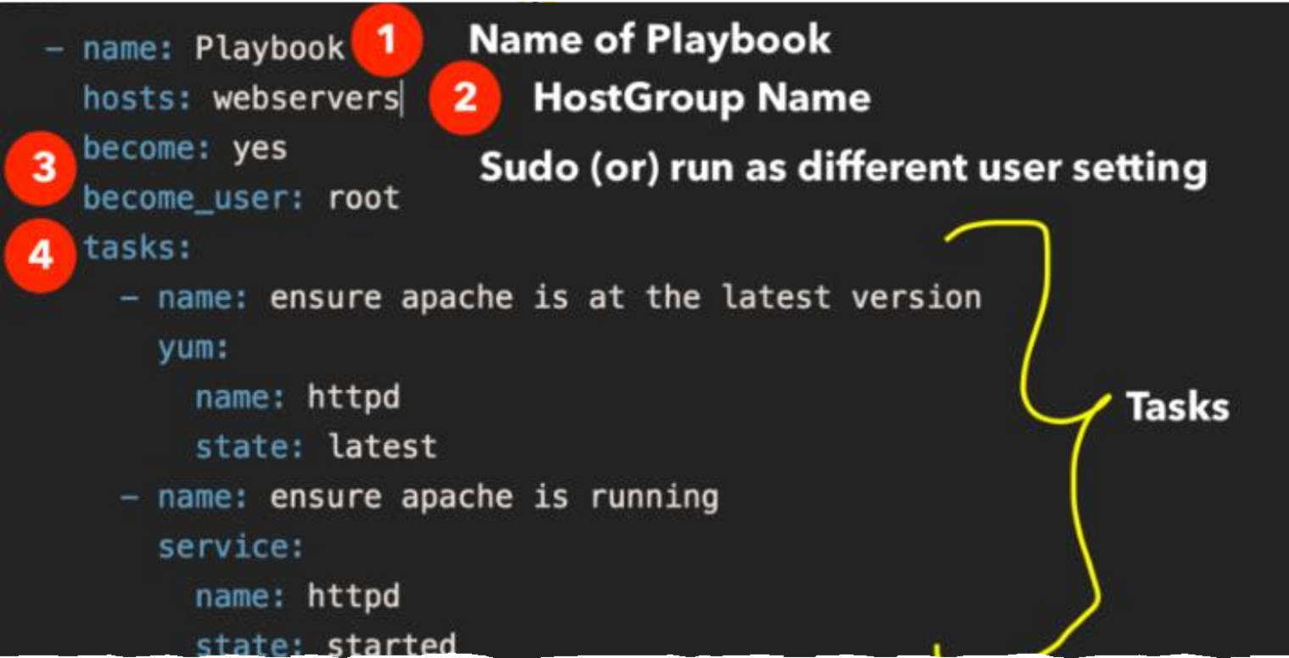
Playbook Structure
.

Slide 11
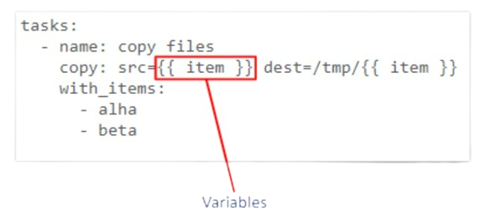
Ansible Playbook: Variables
Variables can be defined and used anywhere in Ansible even in inventory or in an Ad-Hoc Command
Variables extent the functionality of conditionals and loops in Ansible

Slide 12
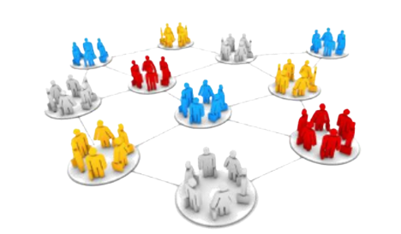
Ansible Roles
Overtime working with Ansible a user may create hundreds of playbooks, variables, templates, defaults etc. Roles allow users to group this logic into an organized manner making reusability and sharing of Ansible structure easier.

Slide 13
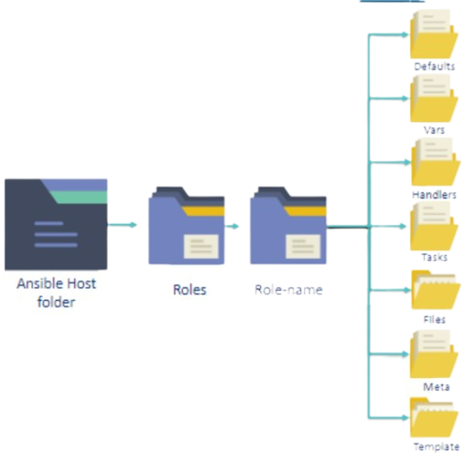
Ansible Roles
Roles uses directories to structure and group all
the playbooks, variables, templates, tasks,
handlers files, and defaults.
This collected logic can be grouped in any way
the user wants, for example you can group
server specific roles together
These roles can then be used inside playbooks
and even as in-line commands.

